Slide 1

VLSI CMOS
4 BIT DIVIDER
CIRCUIT DESIGN
90nm Technology
GVHD: TS. Phạm Văn Khoa
Thành viên nhóm:
Phạm Quốc Thắng – 18161153
Trần Trung Thắng - 18119121
Đinh Nhật Khang - 19119099
Bùi Chí Ngoan - 18119099
Huỳnh Khánh Duy - 19110981
Trần Huy Khang - 19119101

Slide 2
Phân công công việc | Transistor count
Phạm Quốc Thắng | Tìm hiểu các cổng logic cơ bản
Trần Trung Thắng | Tìm hiểu Tranmisstion gate, Mux
Đinh Nhật Khang | Tìm hiểu Carry Look Ahead Adder
Bùi Chí Ngoan | Tìm hiểu FlipFlop D
Huỳnh Khánh Duy | Tìm hiểu SynCounter 4 bit
Trần Huy Khang | Nguyên lý hoạt động Divider
VLSI CMOS
4 BIT DIVIDER
CIRCUIT DESIGN
90nm Technology

Slide 3
Mục tiêu
Hiểu rõ về nguyên lý hoạt động của mạch chia 4 bit
Mô phỏng được hoạt động của mạch bằng ứng dụng Cadence trên công nghệ 90nm
Đánh giá được hoạt động, độ trễ lan truyền và công suất tiêu thụ của mạch

Slide 4
Outline
Tổng quan về các cổng logic
Multiplexer
Carry Look Ahead Adder
FlipFlop D
Counter
4 Bit Divider
Ứng dụng và đánh giá

Slide 5
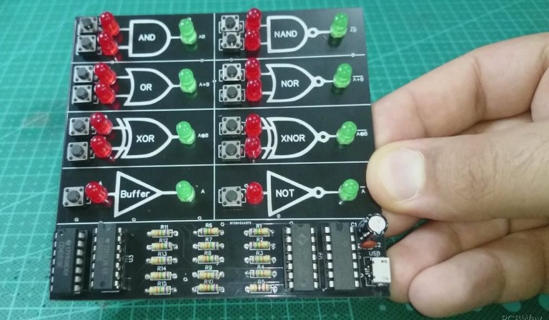
Các cổng logic chủ yếu:
Cổng NOT
Cổng NAND
Cổng XOR
Cổng AND
Cổng OR

Slide 6
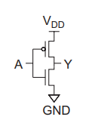
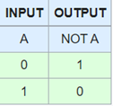
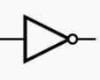
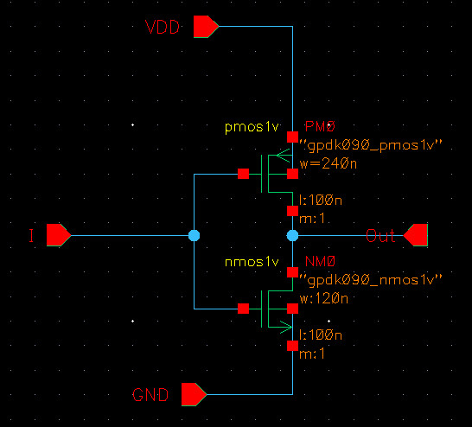
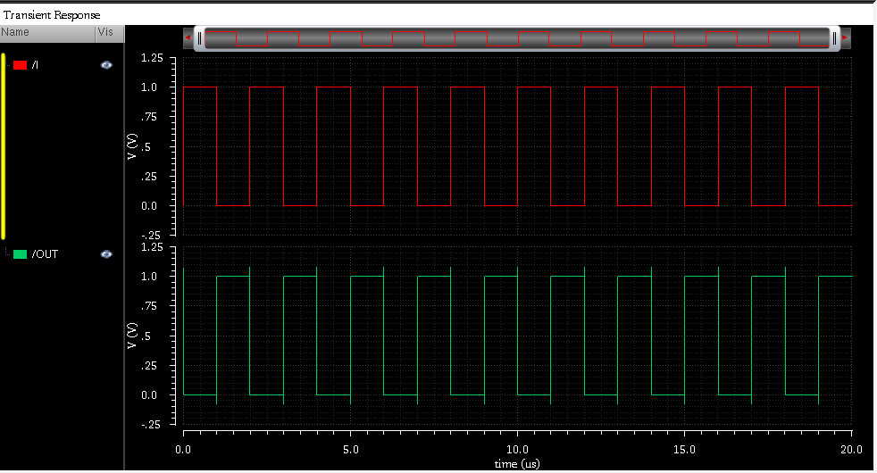
NOT GATE
Bảng trạng thái:
Kí hiệu:
Dạng sóng:

Slide 7
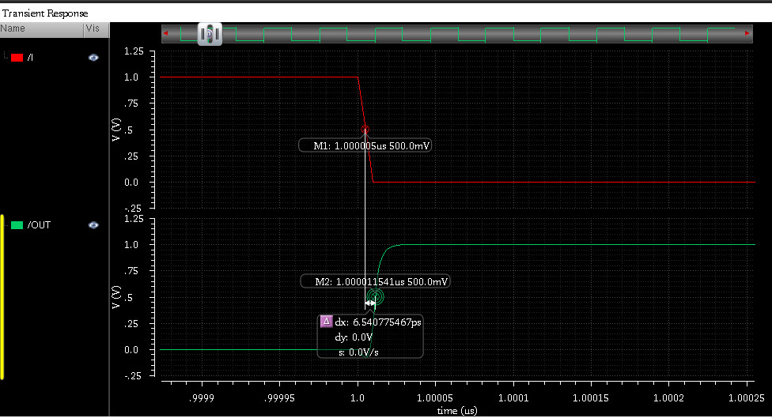
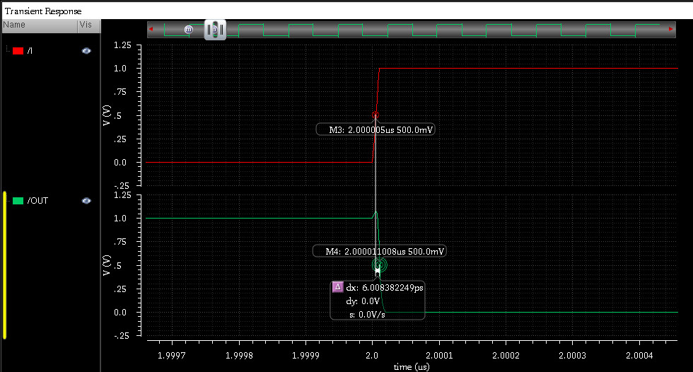

Propagation delay
TpLH=6.54 (ps)
Tp$=\frac{TpLH+TpHL}{2}$=6.274 (ps)
TpHL=6.008 (ps)
Vdd = 1V f = 100Mhz

Slide 8
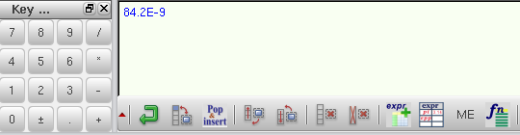
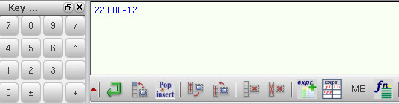
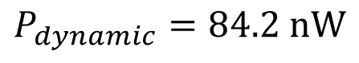

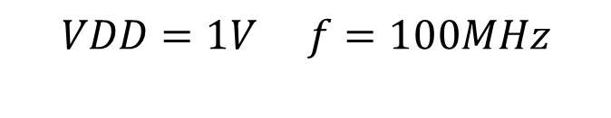

Power Consumption
$$P_{dynamic}=84.2 nW$$
$$P_{static}=0.22 nW$$
$$VDD=1V f=100MHz$$
$P_{total}=P_{dynamic}$ + $P_{static}=84.42 nW$

Slide 9
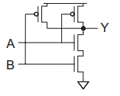
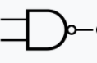
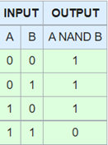
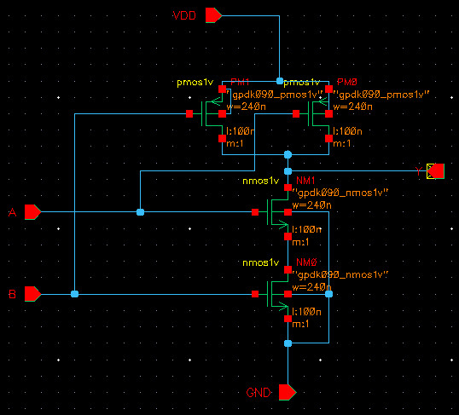
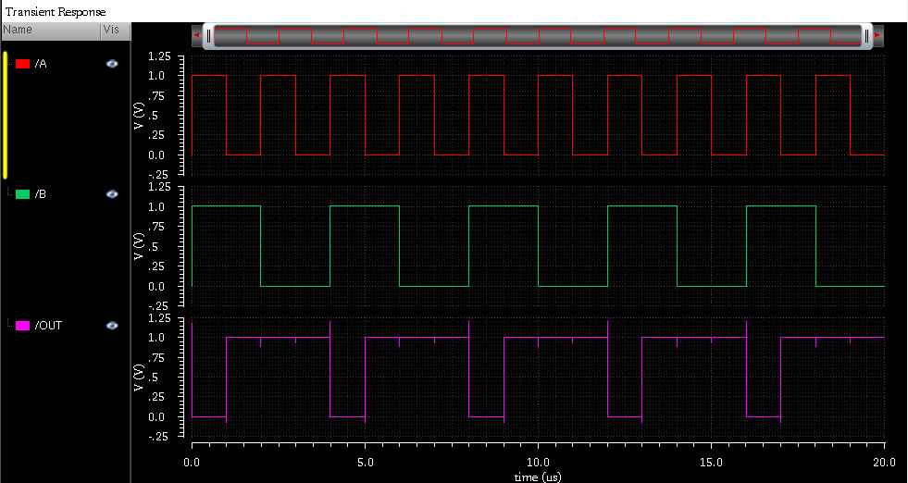
NAND GATE
Bảng trạng thái:
Kí hiệu:

Slide 10
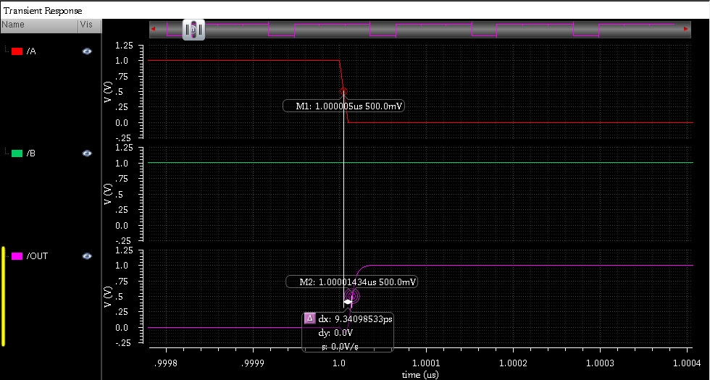
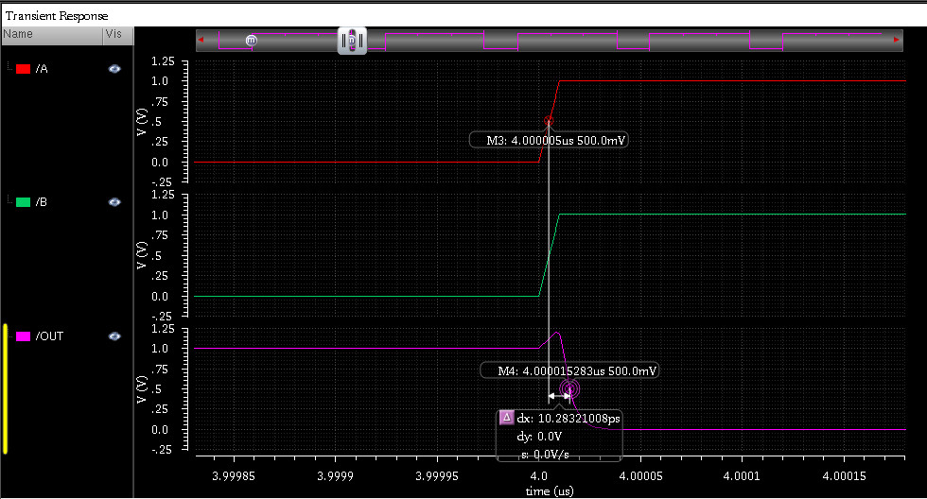

Propagation delay
TpLH=9.34 (ps)
Tp$=\frac{TpLH+TpHL}{2}$=9.76 (ps)
TpHL=10.28 (ps)
Vdd = 1V f = 100Mhz

Slide 11
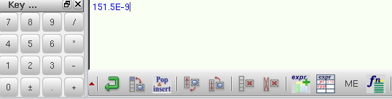
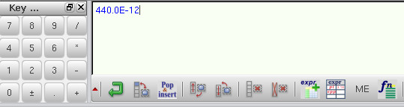
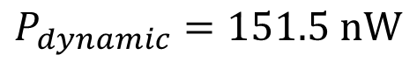

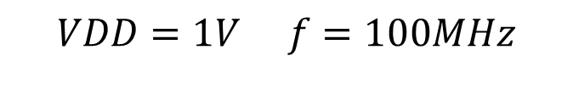
Power Consumption
$$P_{dynamic}=151.5 nW$$
$$P_{static}=0.44 nW$$
$$VDD=1V f=100MHz$$
$P_{total}=P_{dynamic}$ + $P_{static}=151.94 nW$

Slide 12
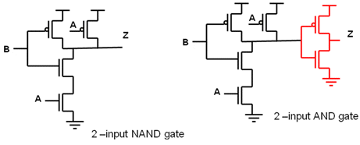
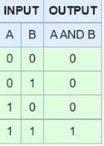
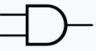
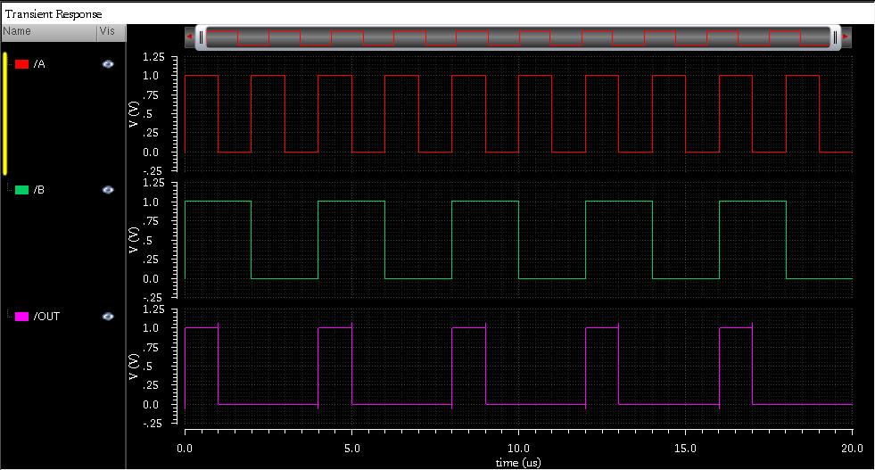
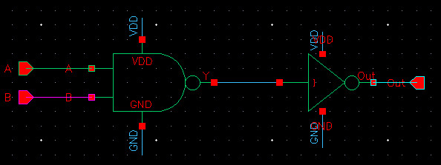
AND GATE
Bảng trạng thái:
Kí hiệu:

Slide 13
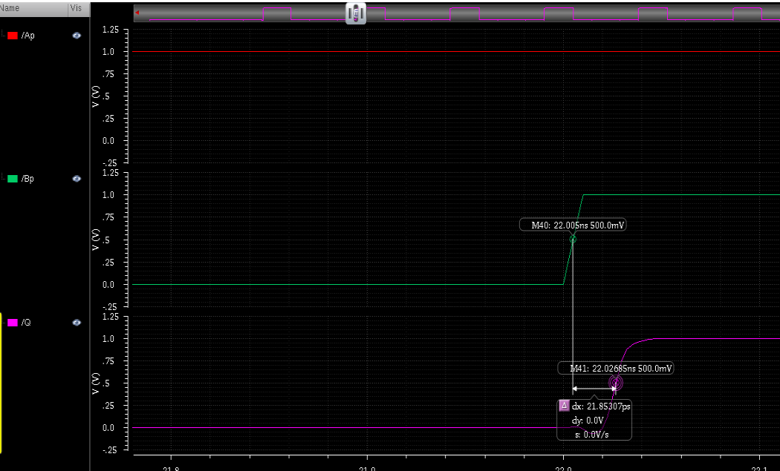
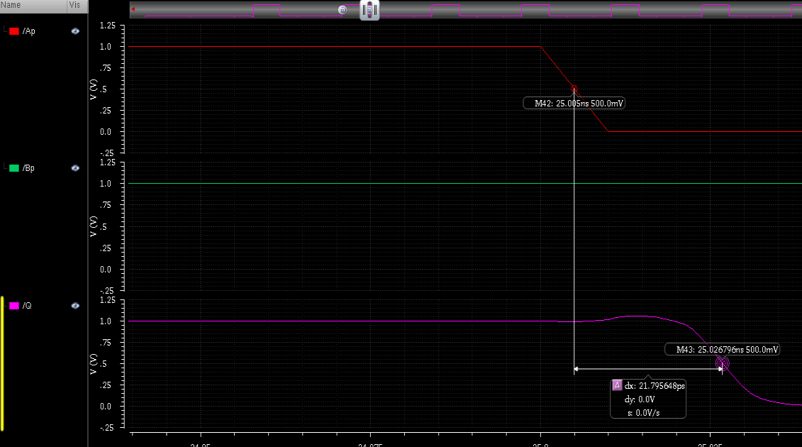
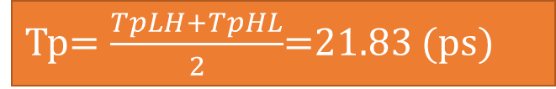
Propagation delay
TpLH=21.85 (ps)
Tp$=\frac{TpLH+TpHL}{2}$=21.83 (ps)
TpHL=21.80 (ps)
Vdd = 1V f = 100Mhz

Slide 14
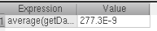
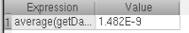
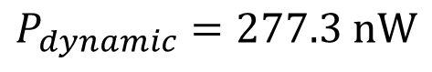

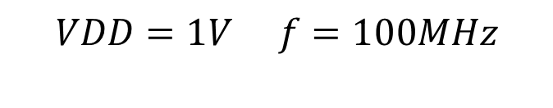
Power Consumption
$$P_{dynamic}=277.3 nW$$
$$P_{static}=1.48 nW$$
$$VDD=1V f=100MHz$$
$P_{total}=P_{dynamic}$ + $P_{static}=278.78 nW$

Slide 15
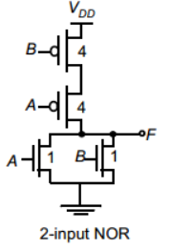
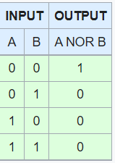
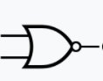
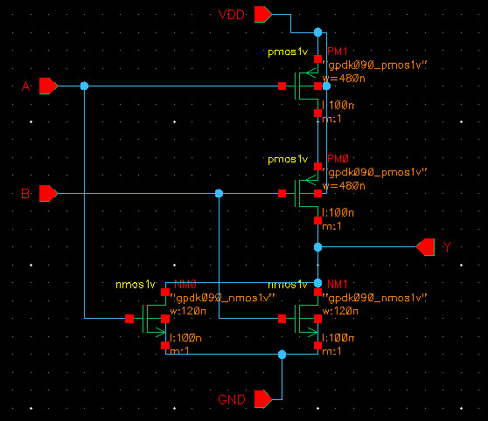
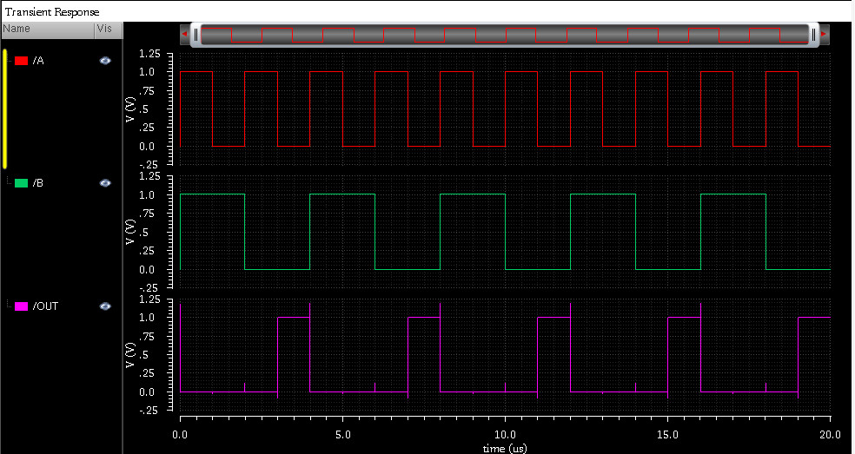
NOR GATE
Bảng trạng thái:
Kí hiệu:

Slide 16
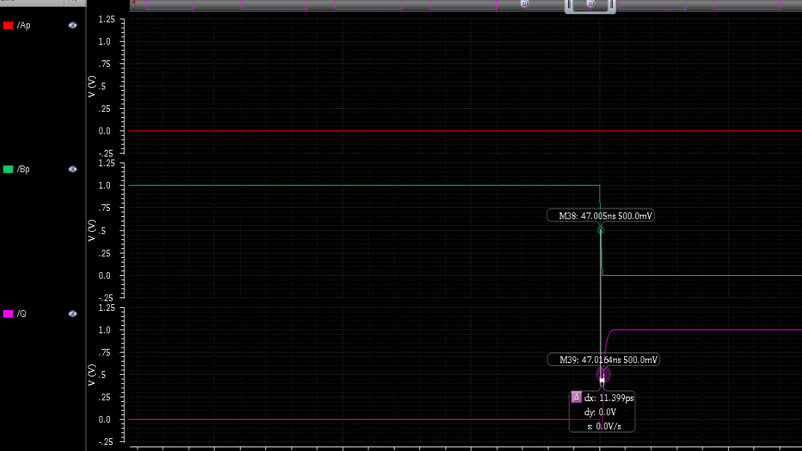
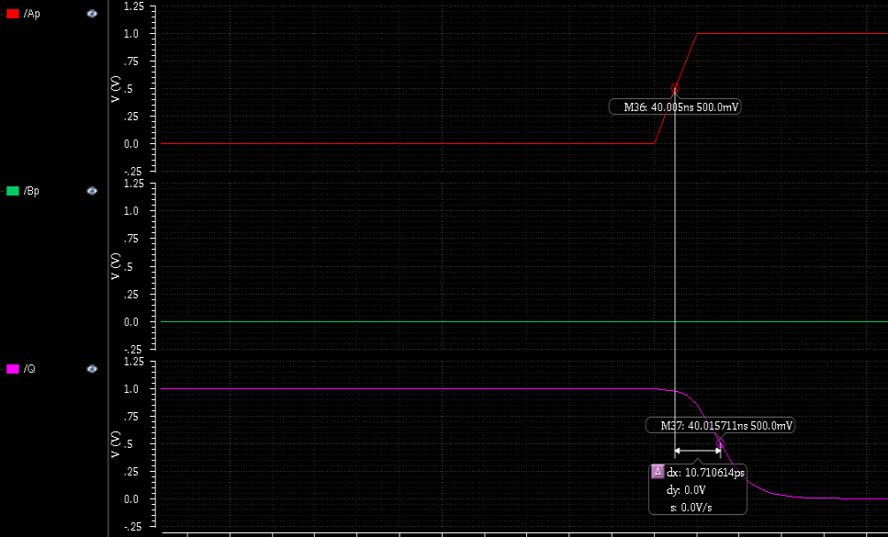

Propagation delay
TpLH=11.4 (ps)
Tp$=\frac{TpLH+TpHL}{2}$=11.06 (ps)
TpHL=10.71 (ps)
Vdd = 1V f = 100Mhz

Slide 17
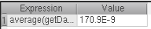
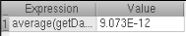
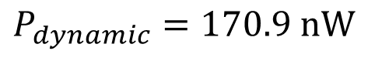

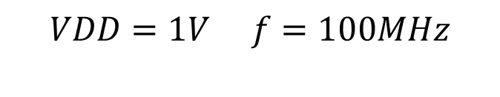
Power Consumption
$$P_{dynamic}=170.9 nW$$
$$P_{static}=0.0091 nW$$
$$VDD=1V f=100MHz$$
$P_{total}=P_{dynamic}$ + $P_{static}=170.91 nW$

Slide 18
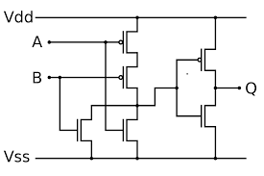
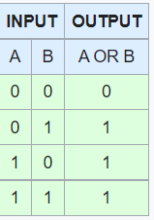
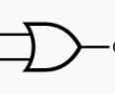
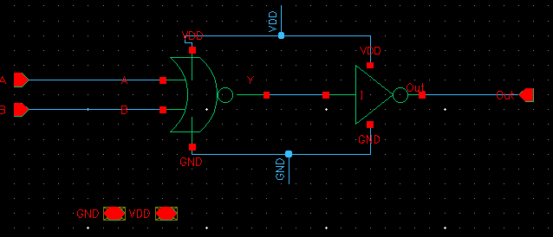

OR GATE
Bảng trạng thái:
Kí hiệu:

Slide 19



Propagation delay
TpLH=24.76 (ps)
Tp$=\frac{TpLH+TpHL}{2}$=25.45 (ps)
TpHL=26.14 (ps)
Vdd = 1V f = 100Mhz

Slide 20





Power Consumption
$$P_{dynamic}=324.4 nW$$
$$P_{static}=25.07 nW$$
$$VDD=1V f=100MHz$$
$P_{total}=P_{dynamic}$ + $P_{static}=349.47 nW$

Slide 21





XOR GATE
Bảng trạng thái:
Kí hiệu:

Slide 22



Propagation delay
TpLH=9.83 (ps)
Tp$=\frac{TpLH+TpHL}{2}$=9.88 (ps)
TpHL=9.93 (ps)
Vdd = 1V f = 100Mhz

Slide 23





Power Consumption
$$P_{dynamic}=232 nW$$
$$P_{static}=25.6 nW$$
$$VDD=1V f=100MHz$$
$P_{total}=P_{dynamic}$ + $P_{static}=257.6 nW$

Slide 24

(ps)
($1V,100Mhz)$

Slide 25

(nW)

Slide 26




Tranmisstion gate

Slide 27





Multiplexers 2 to 1
Tranmisstion gate Mux 2 to 1
Symbol
Schematic
Wave form

Slide 28



Propagation delay
TpLH=13.4 (ps)
Tp$=\frac{TpLH+TpHL}{2}=15.05$ (ps)
TpHL=16.7 (ps)
Vdd = 1V f = 100Mhz

Slide 29










Power Consumption
$$VDD=1V$$
$$f=50MHz$$
$$f=100MHz$$
$$P_{dynamic}=75.73 nW$$
$$P_{dynamic}=147.6 nW$$
$$P_{static}=129.6pW$$
$${P=P}_{dyn}{+P}_{sta}=75.85 nW$$
$${P=P}_{dyn}{+P}_{sta}=147.72 nW$$

Slide 30


Full Adder 1 bit
in
Sum = A⊕B⊕Cin
Cout= (A⊕B) & Cin | (A & B)
Full Adder 1 bit

Slide 31

Full Adder 4 bit
Propagation delay = n bit x TpFA

Slide 32









Full Adder 4 bit
$$⇒$$
$$⇒$$
$$⇒$$

Slide 33




Full Adder 4 bit

Slide 34

Full Adder 4 bit

Slide 35

Full Adder 4 bit

Slide 36

Full Adder 4 bit

Slide 37

Full Adder 4 bit

Slide 38

Full Adder 4 bit

Slide 39


Full Adder 4 bit
Schematic
Symbol

Slide 40

1
0
1
0
1
0
0
1
0
1
1
0
1
0
1
0
0
1
1
0
0
1
0
0
1
1
Wave form

Slide 41



Propagation delay
Cout Output
TpLH= 62.18 ps
Tp$=\frac{TpLH+TpHL}{2}$= 55.51 ps
TpHL= 48.83 ps
Vdd = 1V f = 100Mhz

Slide 42






Propagation delay
S3 Output
Tp$=\frac{TpLH+TpHL}{2}$= 82.23 ps
TpLH= 94.14 ps
TpHL= 70.32 ps
Vdd = 1V f = 100Mhz
S2 Output
Tp$=\frac{TpLH+TpHL}{2}$= 70.09 ps
TpLH= 76.46 ps
TpHL= 63.72 ps

Slide 43






Propagation delay
S1 Output
Tp$=\frac{TpLH+TpHL}{2}$= 76.71 ps
TpLH= 76.39 (ps)
TpHL= 77.02 (ps)
Vdd = 1V f = 100Mhz
S0 Output
Tp$=\frac{TpLH+TpHL}{2}$= 31.92 ps
TpLH= 41.42 (ps)
TpHL= 22.42 (ps)

Slide 44










Power Consumption
$$VDD=1V$$
$$f=100MHz$$
$$f=500MHz$$
$$P_{dynamic}=8.24 uW$$
$$P_{dynamic}=37.31 uW$$
$$P_{static}=1.07 uW$$
$${P=P}_{dyn}{+P}_{sta}=9.31 uW$$
$${P=P}_{dyn}{+P}_{sta}=38.38 uW$$

Slide 45



D – Flip Flop
Master
Slave
Master – Slave D flipflop

Slide 46




D – Flip Flop

Slide 47



Propagation delay
TpLH=87.67 (ps)
Tp$=\frac{TpLH+TpHL}{2}$=100.58 (ps)
TpHL=113.5 (ps)
Vdd = 1V f = 100Mhz

Slide 48










Power Consumption
$$VDD=1V$$
$$f=100MHz$$
$$f=500MHz$$
$$P_{dyn}=2.54uW$$
$$P_{dyn}=6.44uW$$
$$P_{sta}=79.2 nW$$
$${P=P}_{dyn}{+P}_{stac}=2.62 uW$$
$${P=P}_{dyn}{+P}_{stac}=6.52 uW$$

Slide 49




D – Flip Flop

Slide 50



Propagation delay
TpLH=96.81 (ps)
Tp$=\frac{TpLH+TpHL}{2}$=109.89(ps)
TpHL=122.98 (ps)
Vdd = 1V f = 100Mhz

Slide 51










Power Consumption
$$VDD=1V$$
$$f=100MHz$$
$$f=500MHz$$
$$P_{dynamic}=2.69 uW$$
$$P_{dynamic}=12.55uW$$
$$P_{static}=169.5 nW$$
$$P_{total}=2.85 uW$$
$$P_{total}=12.7 uW$$
$P_{total}=P_{dynamic}$ + $P_{static}$

Slide 52


Master-slave D flip-flop with clear input
Truth table
Block diagram

Slide 53


Symbol
Schematic

Slide 54

Wave form

Slide 55



Propagation delay
TpLH= 89.20 ps
Tp$=\frac{TpLH+TpHL}{2}$= 102.25 ps
TpHL= 115.30 ps
Vdd = 1V f = 100Mhz

Slide 56








Power Consumption
$$VDD=1V$$
$$f=100MHz$$
$$f=500MHz$$
$$P_{dynamic}= 2.172 uW$$
$$P_{dynamic}=10.17uW$$
$$P_{static}=0.130 uW$$
$$P_{total}=2.302 uW$$
$$P_{total}=10.2 uW$$
$P_{total}=P_{dynamic}$ + $P_{static}$

Slide 57

Synchronous 4-Bit Up Counter
1
1
1
0
1
1
1
0
0
0
Q0 = D
1
0
1
1
1
0
1
Q1 = D

Slide 58




Synchronous 4-Bit Up Counter
Schematic

Slide 59

Wave form
Schematic

Slide 60



Propagation delay
Q0 Ouput
TpLH=105.46 ps
Tp$=\frac{TpLH+TpHL}{2}$=117.01 (ps)
TpHL=128.56 ps
Vdd = 1V f = 100Mhz

Slide 61



Propagation delay
Q1 Output
TpLH=103.58 ps
Tp$=\frac{TpLH+TpHL}{2}$=115.59 (ps)
TpHL=127.60 ps
Vdd = 1V f = 100Mhz

Slide 62



Propagation delay
Q2 Output
TpLH=104.05 ps
Tp$=\frac{TpLH+TpHL}{2}$= 115.87 ps
TpHL=127.68 ps
Vdd = 1V f = 100Mhz

Slide 63



Propagation delay
Q3 Output
TpLH=97.74 ps
Tp$=\frac{TpLH+TpHL}{2}$= 110.25 ps
TpHL=122.75 ps
Vdd = 1V f = 100Mhz

Slide 64


Slide 65








Power Consumption
$$VDD=1V$$
$$f=100MHz$$
$$f=500MHz$$
$$P_{dynamic}=8.28 uW$$
$$P_{dynamic}=37.95uW$$
$$P_{static}=0.87 uW$$
$$P_{total}=9.15 uW$$
$$P_{total}=38.82 uW$$
$P_{total}=P_{dynamic}$ + $P_{static}$

Slide 66




4 – bit Divider
A0
$A −B=A+(\sim B+1$)
S0
1111 - 0111 = 1111 + 1001
= 11000
A1
S1
$$A −B>0$$
$$A −2B>0$$
……
A2
S2
$$A=15 , B=5⇒A −B=10 ⇒A−2B=5$$
$$⇒A−3B=0$$
$$⇒A−4B<0⇒Co=0$$
A3
S3
0
1

Slide 67


4 – bit Divider
Schematic
Symbol

Slide 68

A = 1 1 1 1
0
1
1
0
1
0
1
0
1
1
1
0
0
0
1
0
1
0
1
1
1
1
0
1
1
0
0
0
1
0
1
1
1
1
1
1
1
0
1
0
1
0

Slide 69



Propagation delay
Thương (Q)
TpLH=102.89 (ps)
Tp$=\frac{TpLH+TpHL}{2}$=115.92 (ps)
TpHL=128.94 (ps)
Vdd = 1V f = 100Mhz

Slide 70



Propagation delay
Số dư (R)
TpLH=115.15 (ps)
Tp$=\frac{TpLH+TpHL}{2}$=123.82 (ps)
TpHL=132.49 (ps)
Vdd = 1V f = 100Mhz

Slide 71
















Power Consumption
$$VDD=1V$$
$$f=50MHz$$
$$f=100MHz$$
$$f=500MHz$$
$$P_{dynamic}=12.15 uW$$
$$P_{dynamic}=21.11 uW$$
$$P_{dynamic}=93.16 uW$$
$$P_{static}=3.09 uW$$
$$P_{total}=15.24 uW$$
$$P_{total}=24.2 uW$$
$$P_{total}=96.25 uW$$
$P_{total}=P_{dyn}$ + $P_{sta}$

Slide 72


Slide 73
(ps)
( Vdd = 1V f = 100Mhz )

Slide 74
(uW)

Slide 75
Đánh giá và ứng dụng
Tốc độ hoạt động của mạch chia phụ thuộc vào tốc độ xung clock và thời gian thực hiện chưa được tối ưu
Công suất tiêu thụ khá cao
Ứng dụng trong thiết kế ALU ( phép chia 2 số 4 bit )

Slide 76
Tài liệu tham khảo
CMOS VLSI Design: A Circuits and Systems Perspective (pub.ro)
INTERNATIONAL JOURNAL OF ENGINEERING SCIENCES & RESEARCH TECHNOLOGY : http://www.ijesrt.com/issues%20pdf%20file/Archives-2015/February-2015/59_DESIGN%20AND%20IMPLEMENTATION%20OF%20SERIAL%20DIVIDER%20USING%20180NM%20PROCESS%20TECHNOLOGY.pdf
Carry Look Ahead Adder | 4-bit Carry Look Ahead Adder | Gate Vidyalay

Slide 77

THANKS FOR WATCHING

